Slide 1
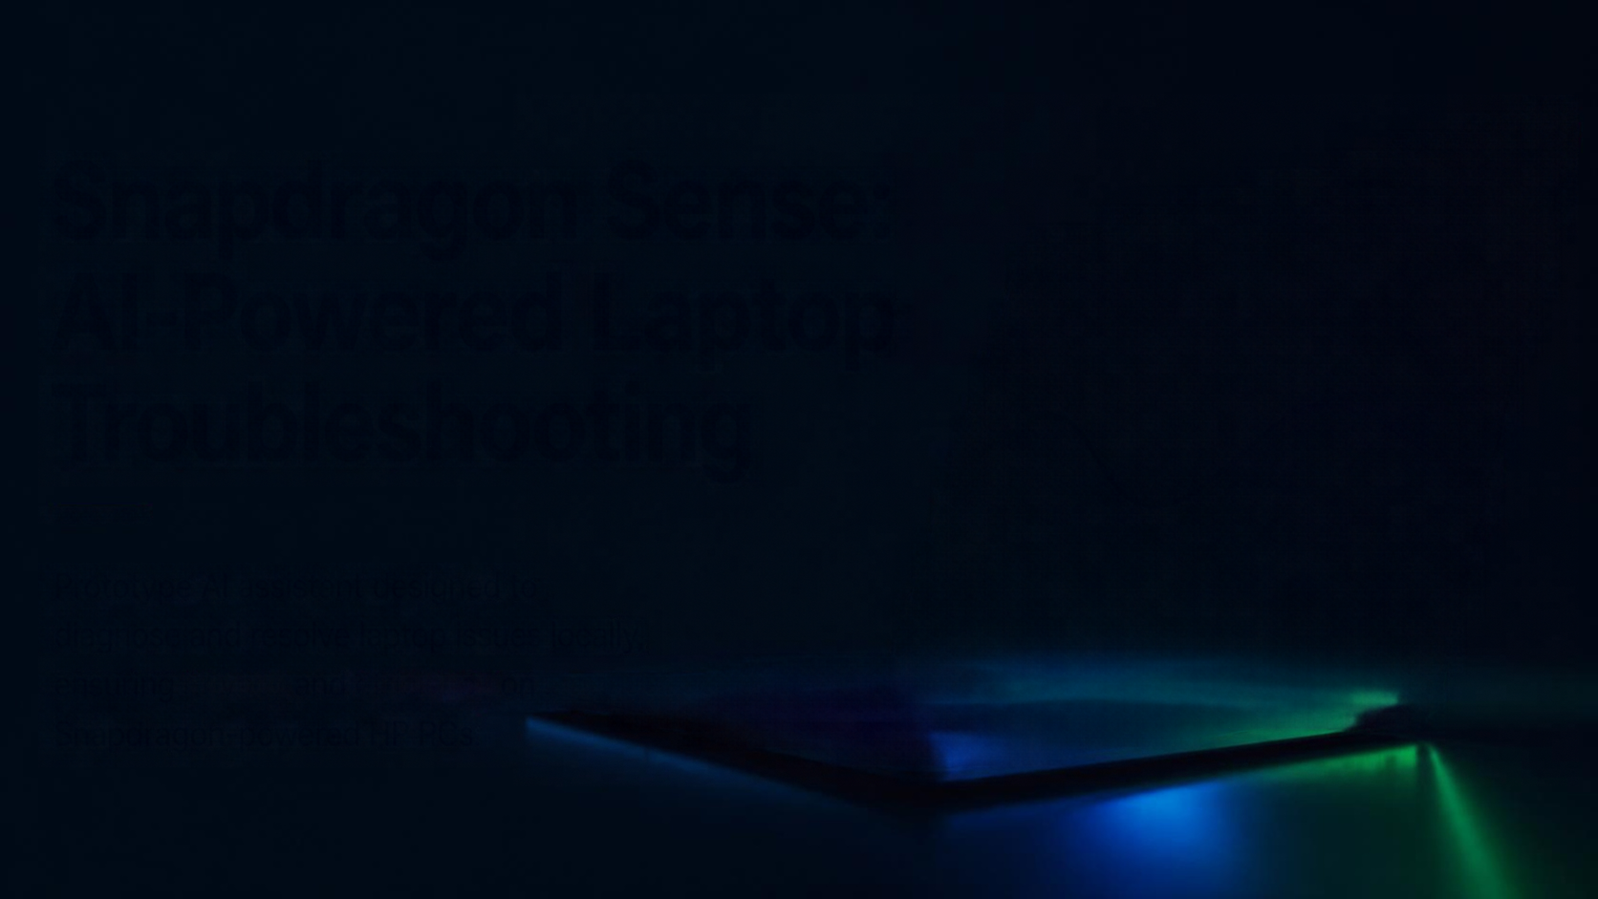

Snapdragon Sense: AI-Powered Laptop Troubleshooting
Prototype AI assistant designed to diagnose and resolve laptop issues locally, ensuring privacy and efficiency on Snapdragon-powered HP PCs.

Slide 2







User Problem
Diagnosing laptop issues is
complex and time-consuming
Limited access to expert support without exposing private data
Dependence on cloud services raises privacy and latency concerns
FRUSTRATED
USER
COMPLEX
ERROR MESSAGES
PRIVACY & LATENCY
RISKS

Slide 3








Proposed Solution
AI-DRIVEN DIAGNOSIS
Analyzes user-provided or simulated device metrics locally.
An AI-powered troubleshooting assistant that delivers accurate, private, and reliable laptop support—built for the future.
INTERACTIVE UI
Streamlit-based interface for simple
and guided user interaction.
SAFE FALLBACK
Rules-based backup ensures dependable guidance when AI is uncertain.
BUILT FOR PRIVACY & EFFICIENCY
Designed for future Snapdragon-powered HP laptops with privacy and efficiency at the core.

Slide 4















User Journey & Demo
1
Launch
Snapdragon Sense
System connected
User opens the Streamlit
interface on their laptop
AI-Powered Laptop Troubleshooting
Describe the issue
Diagnostic summary
2
Share
Tell us what's happening
Likely causes
User enters symptoms
or collects system metrics
  e.g., laptop is slow and fans are loud
  High CPU usage by background process
  Thermal throttling detected
  Low disk space
Collect system metrics
3
Diagnose
Recommended steps
Analyze
Need more help?
AI model analyzes data and returns likely root causes
  Close heavy background apps
  Clean laptop vents and ensure airflow
  Update system drivers
  Restart and monitor performance
Try our fallback actions or contact support.
Fallback actions
4
Resolve
User follows guided steps
or fallback advice to fix

Slide 5









AI & Technical Architecture
OLLAMA
LOCAL MODEL
LOW
CONFIDENCE
RULES-BASED
FALLBACK
STREAMLIT UI
DEVICE METRICS
presents diagnostics
and user inputs
provided by the user
or simulated to
generate diagnostics
open-source AI model
running locally for
on-device inference
safe, conservative
system ensures
reliable advice
INTERACTIVE FRONTEND
INPUTS
AI ANALYSIS
SAFEGUARD
central place for diagnostics and user interaction
real device metrics or
simulated data power
diagnostic generation
local model analyzes metrics and generates clear, actionable guidance
fallback logic provides
reliable recommendations when confidence is low

Slide 6












Snapdragon Fit
ON-DEVICE AI
PRIVACY FIRST
LOW POWER
FUTURE VALIDATION
Built for on-device inference, reducing reliance on the cloud.
Data stays on your device, protecting user privacy.
Optimized for efficiency on Snapdragon-powered
HP laptops.
Performance will be validated and fine-tuned on Snapdragon hardware.

Slide 7


Safety, Limits & Validation Plan
Ai provides diagnostic suggestions, not guaranteed fixes
Rules-based fallback prevents unsafe or uncertain advice
Prototype status emphasizes future optimization and testing
Simulated environment testing with diverse device metrics
User feedback cycles for iterative improvement
Planned performance and compatibility validation
on Snapdragon HP devices

Slide 8








Impact & Next Steps
IMPACT
NEXT STEPS
Empowers users with private, efficient troubleshooting
2
3
1
Reduces support costs and improves device uptime
Optimize AI models for Snapdragon
on-device inference
Develop richer diagnostics and expand device coverage
Collaborate with
HP and Snapdragon teams for validation and deployment
Advances AI integration on Snapdragon platforms

